Slide 1
DDoS Attacks: Detection and Mitigation Techniques
Michael Griffith

Slide 2
I support Freedom of Expression. No matter whose. So I oppose DDoS attacks regardless of their target…they’re the poison gas of cyberspace
John Perry Barlow

Slide 3
Definition
What are DDoS attacks?

Slide 4
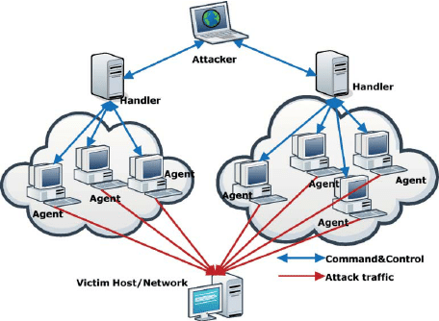
Many-to-one dimension of attack
Exploits open resource access model of the Internet
Sends target a continuous stream of attack packets from coordinated internet hosts for the purpose of denying service to legitimate clients

Slide 5
Examples
Mirai Dyn DDoS attack
October 21, 2016
1 Tbps attack flood, a record
Some data even suggests 1.5 Tbps
Shutdown many websites including GitHub, HBO, Twitter, Reddit, Paypal, and Netflix
Google Attack
Six month period of 2020
Attack flood peaked at 2.5 Tbps
Perpetrated by 3 Chinese ISPs during the U.S. Presidential Election campaign
While Google was affected they did not report major shutdowns

Slide 6
Detection
Is it possible?

Slide 7
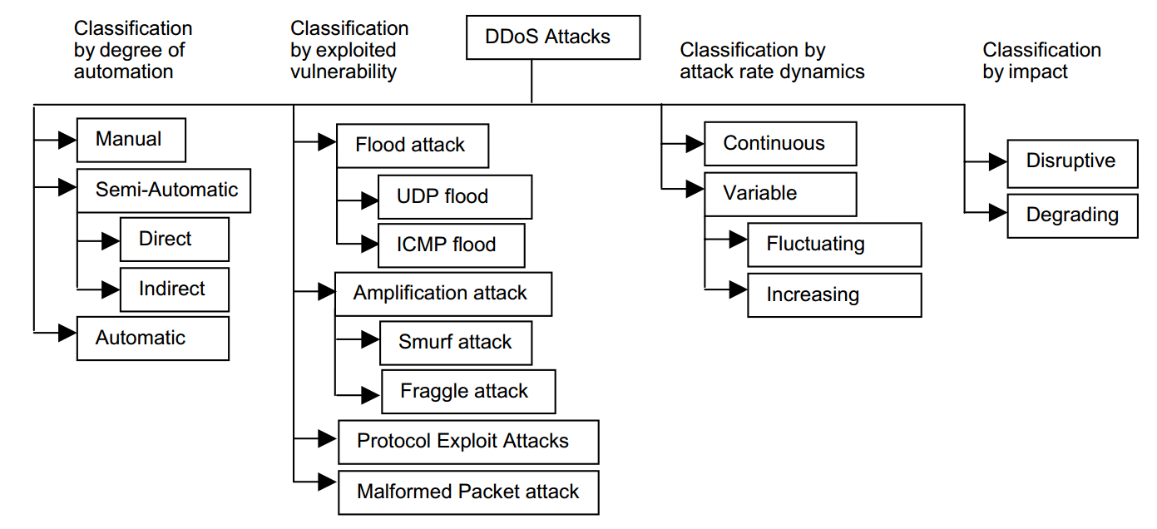
Classifying DDoS Attack

Slide 8
How are they detected?
Many proposed ideas
Most involve the use of statistical analysis of traffic to develop traffic profiles for normal traffic
Packet-level feature inspection is often used and certain features are used for application fingerprinting
Packet length
Packet Inter-arrival time
Time-to-live (TTL)

Slide 9
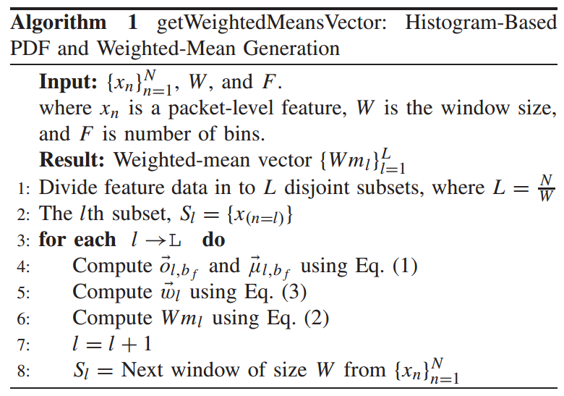
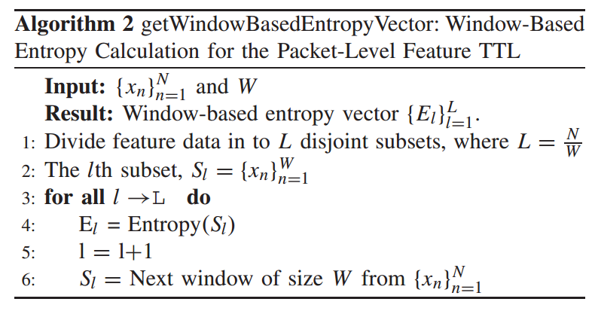
Example Algorithms

Slide 10
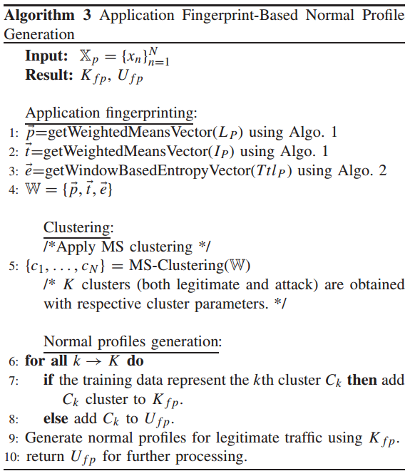
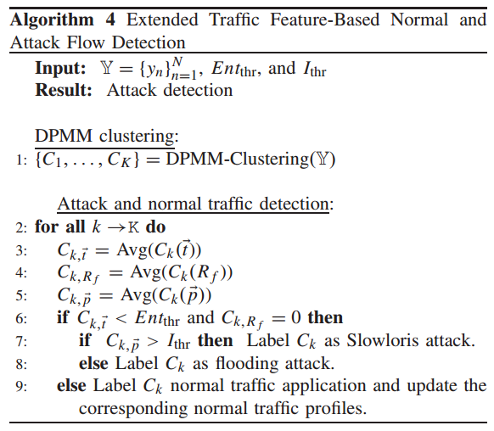

Slide 11
Mitigation
How do we deal with an attack?

Slide 12
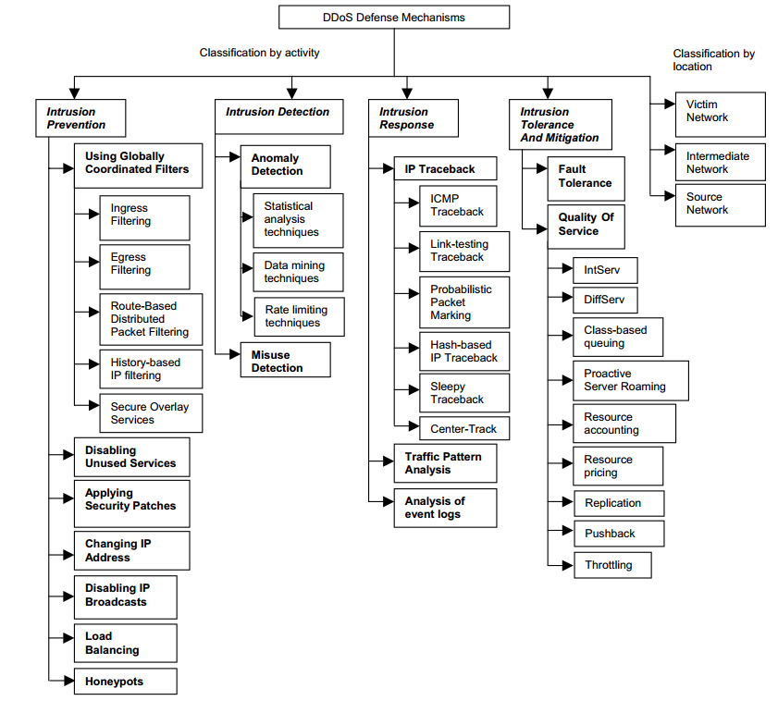

Slide 13
Goals
Mitigation efforts are based on increasing the victims chance to respond to an attack
The main response is to be able to block the attack traffic and decrease any damage done
Tracing back to identify the attacker is another response to attacks besides blocking traffic

Slide 14
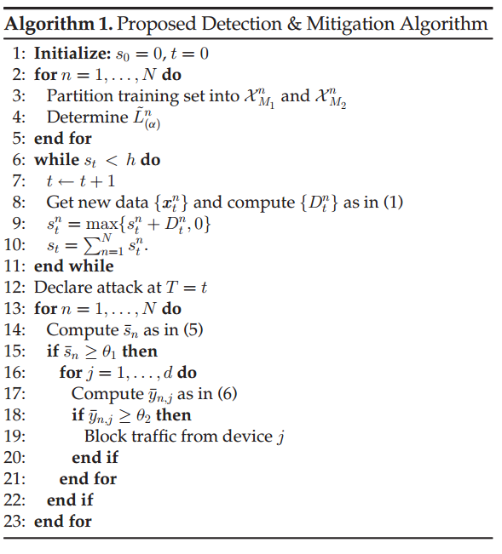
Example
Proposed Algorithm for Stealthy DDoS via IoT Networks

Slide 15
Conclusion
DDoS attackers have an advantage over defenders
No method is perfect and research and proposals are continuing and are more important than ever before.

Slide 16
Citations
Christos Douligeris, Aikaterini Mitrokotsa, DDoS attacks and defense mechanisms: classification and state-of-the-art, Computer Networks, Volume 44, Issue 5, 2004, Pages 643-666, ISSN 1389-1286, https://doi.org/10.1016/j.comnet.2003.10.003. (https://www.sciencedirect.com/science/article/pii/S1389128603004250)
K. Doshi, Y. Yilmaz and S. Uludag, "Timely Detection and Mitigation of Stealthy DDoS Attacks Via IoT Networks," in IEEE Transactions on Dependable and Secure Computing, vol. 18, no. 5, pp. 2164-2176, 1 Sept.-Oct. 2021, doi: 10.1109/TDSC.2021.3049942.
M. E. Ahmed, S. Ullah and H. Kim, "Statistical Application Fingerprinting for DDoS Attack Mitigation," in IEEE Transactions on Information Forensics and Security, vol. 14, no. 6, pp. 1471-1484, June 2019, doi: 10.1109/TIFS.2018.2879616.
Nicholson, Paul. “Five Most Famous Ddos Attacks and Then Some.” A10 Networks, 20 Feb. 2021, https://www.a10networks.com/blog/5-most-famous-ddos-attacks/.

